Slide 1










Slide 2

Nott Tuesday 2014 Startup of the year awards

Slide 3
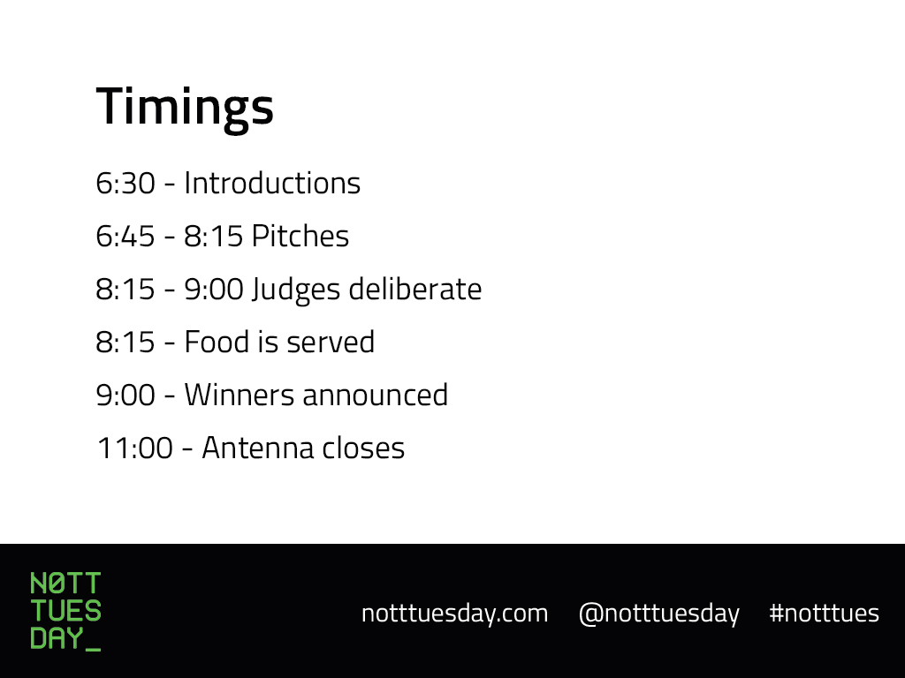
Timings
6:30 (sharp start) Introductions
6:45 – 8:15 Pitches
8:15 – 9:00 Judges deliberate
8:15 - Food is served
9:00 Winners announced
11:00’ish Antenna closes

Slide 4

Gold & Silver Sponsors

Slide 5

Platinum Sponsors

Slide 6

Cash Prize Sponsors

Slide 7
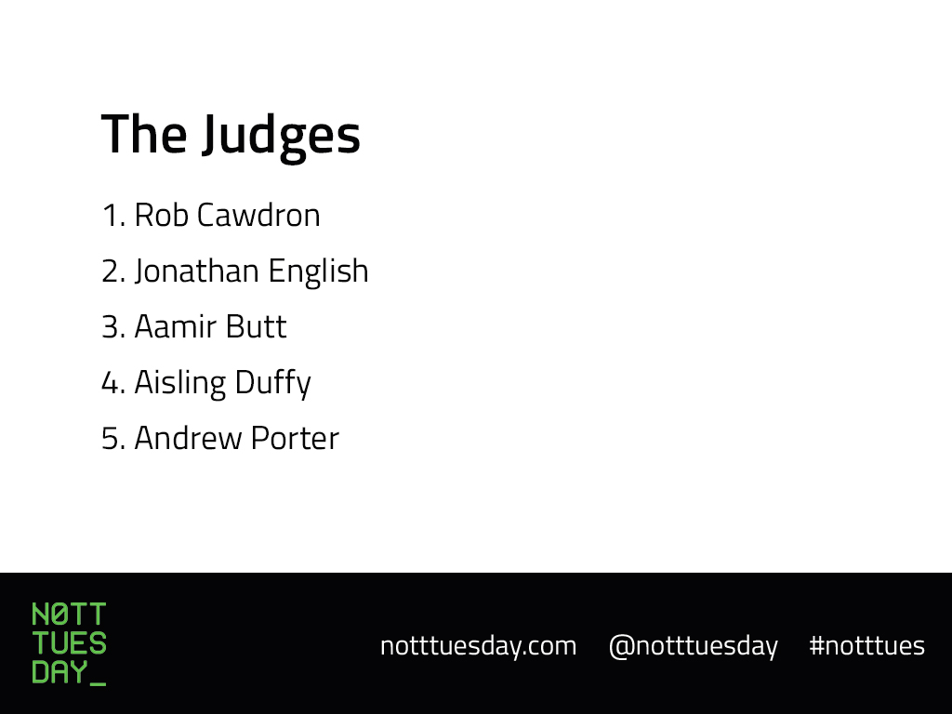
The Judges
Rob Cawdron
Jonathan English
Aamir Butt
Aisling Duffy
Andrew Porter

Slide 8
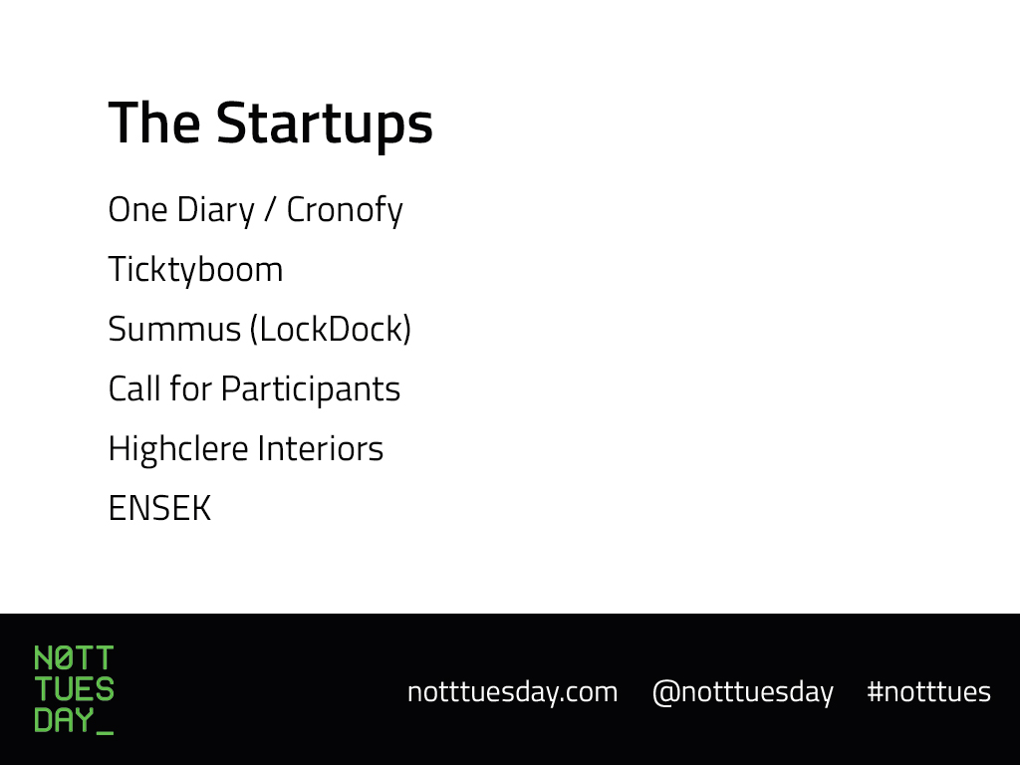
The Startups
One Diary / Cronofy
Ticktyboom
Summus (LockDock)
Call for Participants
Highclere Interiors
ENSEK

